Slide 1
Procurement’s Critical Role in Supply Chain Management
Lunch & Learn 21 Sept 21

Slide 2
Introductions

Slide 3

​
Paul Moriarty possesses more than 25 years in the fields of Supply Chain Management and Operations fields. He has several nationally recognized, professional certifications: CPSM (Certified Professional in Supply Management from Institute for Supply Management), CLTD (Certified Logistics, Transportation, and Distribution from APICS), CPIM (Certified Planning and Inventory Manager from APICS), and CSCP (Certified Supply Chain Professional from APICS).
Paul is a certified instructor for CLTD, CPIM, CSCP, as well as CPSM.
Paul developed and taught project management, operations and supply management courses for local companies and colleges.
Paul is currently the President of Northern New England chapter of ASCM

Slide 4
What is a procurement to you?
What does this mean to you?

Slide 5
Definitions
PROCUREMENT -
“Organizational function that includes specifications, development, value analysis, supplier market research, negotiation, buying activities, contract administration, inventory control, traffic, receiving, and stores” - ISM
BUYING (AKA - Purchasing) –
“ A major function of an organization that is responsible for acquisition of required materials, services, and equipment” - ISM

Slide 6
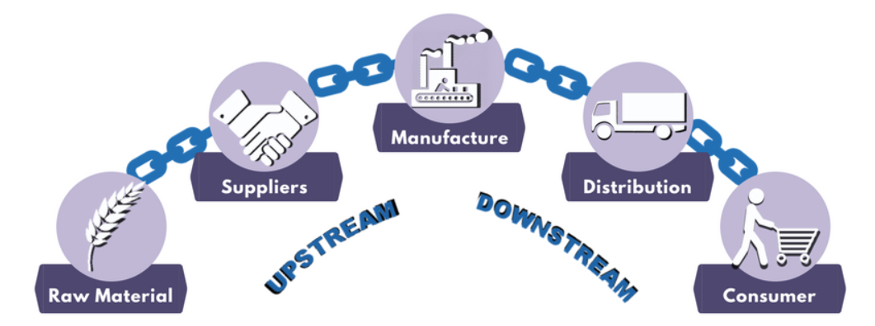

Slide 7
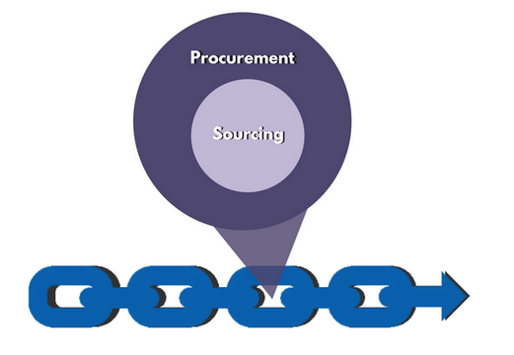

Slide 8
Procurement is, typically, divided into two areas:
  Strategic –
    Establish supply management strategy
    Preform market research
    Negotiate/finalize contracts
      Manage contracts
    Supplier performance and relations
    Spend analysis

Slide 9
Procurement is, typically, divided into two areas: (continued)
  Tactical –
    Forecasting
    Planning for internal customer needs
    Preparing purchasing requisitions and statements of work
    Supplier selection
    Aligning customer orders with supplier forecasts
    Establishing ROPs for inventory

Slide 10
Efficient procurement seeks
Provides the following benefits:
Lowers overall costs
Reduces associated supply chain risk
Improves quality
Brings greater added value
Increases operational efficiency
Ensures security of the supply chain

Slide 11
Procurement function –
  Reduction of material costs is not just beating up suppliers for lower prices but working towards a mutually beneficial understanding on
    deliveries
    quality
    processes to be followed
    Schedules
    Supplier involvement with product development

Slide 12
Procurement function –
  Contract initiation and management
      Not, typically, relegated the tactical buying
      Be able to negotiate contacts on behalf of firm
        Including acceptable changes
  Need to understand changes in environment and adapt
      Social changes
      Economic changes
      Materials changes (both raw and retail)

Slide 13
Impact of COVID on Procurement
  Supply chain shortages and disruptions
    Difficulty in obtaining raw materials and services
      Labor shortages
        Right mix
      Key components
        Integrated circuits

Slide 14
Impact of COVID on Procurement
  Supply chain shortages and disruptions
    Transportation problems
      Containerization –
      Port congestion
      Driver retirement
      Distribution centers - wrong place/ wrong capacity

Slide 15
Impact of COVID on Procurement
  An example of one of a key challenge faced in supply chain operations
    Controlling costs
      Costs of containerization has dramatically increased
        Some cases, costs have gone from $1,000 to $2,000 to over $19,000
        On the low end – those costs have more than quadrupled
      In the case of a large retailer – Walmart has leased their own ships to supply its needs

Slide 16
Impact of COVID on Procurement
  Other examples of challenge faced by the procurement function
    Changes in markets
      More on-line purchasing (e.g., Amazon, Wayfair Door dash, etc.)
      Changes in consumers' perceptions of needs and wants
        Food, beverages, personal needs can be brough to the consumer’s door
        Remote workers seeking changes in ‘lifestyles’

Slide 17
Summary
In general, the distinction made between Procurement and Purchasing can be somewhat subjective and certainly situational. Companies tend to lump these functions into ‘Purchasing’
Procurement as being indicative of more strategic planning and longer-term activities.
In smaller companies. - Whoever works in Procurement, or Purchasing, must do anything and everything necessary to get the job done.

Slide 18
Summary
Must deal with growing challenges to meet Supply Chain requirements
  Deal with the changes quickly
  Strategically – when not putting out ‘fires’
  Control costs and quality

Slide 19
  Questions?

Slide 20
This presentation will be made available on the Northern New England ASCM web site and will be shared with Minute Man ASCM web site latter this week

Slide 21
I can be reached via
president@northernnewengland.ascm.org
Or
pfmoriarty@myfairpoint.net
phone# 603-616-1624

